Slide 1
Multiprogramming and Multiprocessor Systems
Week 4

Slide 2
Multiprogramming
Multiprogramming keeps several processes in memory at the same time
While one process uses the CPU, another can use an I/O device, and the rest wait in line
  Device work overlaps with CPU work, so less time is wasted
The number of processes in memory at once is the degree of multiprogramming
  With a degree of 1, only one process is in memory, and the CPU sits idle every time it waits for I/O

Slide 3
Quick Review from Week 2
A process is a program that's running, or waiting for the CPU or I/O
The OS keeps a line (queue) for each service, such as the CPU or a drive
A context switch saves one process and loads another
The scheduler picks which process runs next (Week 5)

Slide 4
Requirements for Multiprogramming
Keep the CPU and other resources busy as much as possible
With one CPU, only one process actually runs at a time. The others wait in the ready queue
Processes also need passive resources, such as memory

Slide 5
OS Features Needed for Multiprogramming
I/O routines supplied by the system, such as device drivers
Memory management, to keep processes apart (Week 11)
CPU scheduling (Week 5)
Handing out devices fairly

Slide 6
Model of a System with Multiprogramming
A simple model has one CPU, one I/O device, and three queues:
  Processes waiting for memory
  The ready queue, for the CPU
  The I/O queue, for the device
The CPU and the device work at the same time, on different processes

Slide 7
Multiprocessor Systems
A computer with more than one processor, or more than one core
Benefits: more processing power, and use as many processors as the work needs
Extra jobs for the OS:
  Keep all processors busy, with work spread evenly
  Make sure every processor sees the same, up-to-date copy of shared data
  Keep related processes in step, and stop them from changing shared data at the same time (mutual exclusion)

Slide 8
Multi-core Is Everywhere
Socket: a physical processor chip. Most laptops and phones have one, and big servers may have two or more
Core: a complete processor inside the chip. Phones have 6 to 8, and server chips can have over 100
Logical processor: what the OS sees. With hyper-threading, each core shows up as two
Check yours: Task Manager, Performance, CPU on Windows, or lscpu and nproc on Linux
Notes:
Linux manual page: lscpu: https://man7.org/linux/man-pages/man1/lscpu.1.html

Slide 9
Flynn's Categories
Flynn's categories sort computers by how many instructions and how much data they handle at once
  SISD: one instruction on one piece of data. A classic single-core processor
  SIMD: the same instruction on lots of data at once. Built into every modern CPU, and how GPUs work
  MISD: several instructions on the same data. Rarely used
  MIMD: different instructions on different data. Any multi-core processor
Historical note: VLIW chips, such as Intel's Itanium, packed several instructions into one. Itanium has been discontinued. Still worth knowing because you may meet the term in older servers and textbooks
Notes:
Arm: Neon: https://www.arm.com/technologies/neon

Slide 10
Processor Interconnection Schemes
How processors and memory are connected inside a computer
The classic designs, pictured on the next slide:
  Shared bus: everyone shares one connection, like one hallway
  Crossbar switch: a switch for every processor and memory pair, like a grid of doors
  Mesh: each node connects to its neighbors, like city blocks
  Hypercube: nodes at the corners of cubes, connected corner to corner
Today, the cores in one chip are linked by a fast on-chip network, and AMD builds processors from several small chips (chiplets) in one package

Slide 11
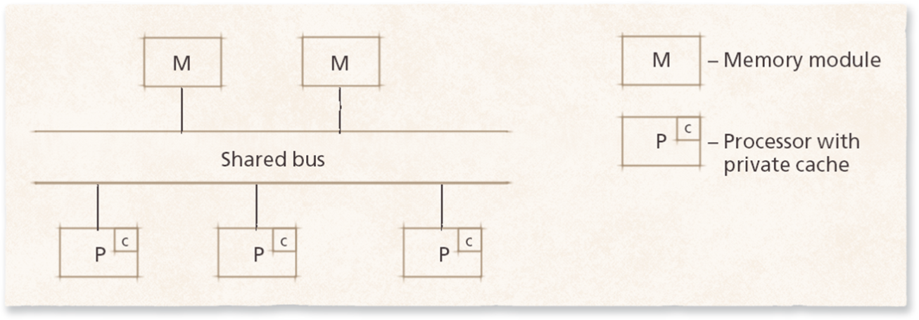
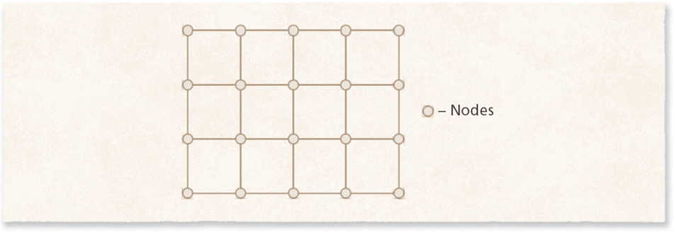
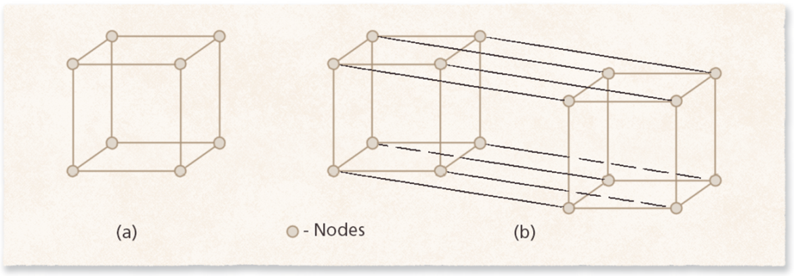
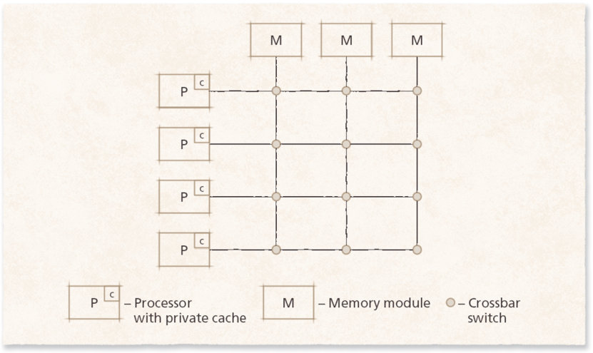
Processor Interconnection Schemes
Mesh
Shared Bus
Hypercubes
Crossbar Switch Matrix

Slide 12
Loosely Coupled vs. Tightly Coupled Systems
Tightly coupled: processors share most resources, including memory
  More efficient, and easier for OS programmers
Loosely coupled: each processor has its own memory, and they talk by sending messages
  More flexible, survive failures better, and can grow bigger
A multi-core laptop is tightly coupled. A cluster of servers is loosely coupled (Week 14)

Slide 13
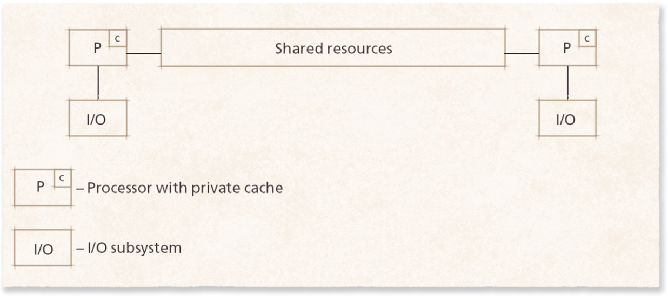
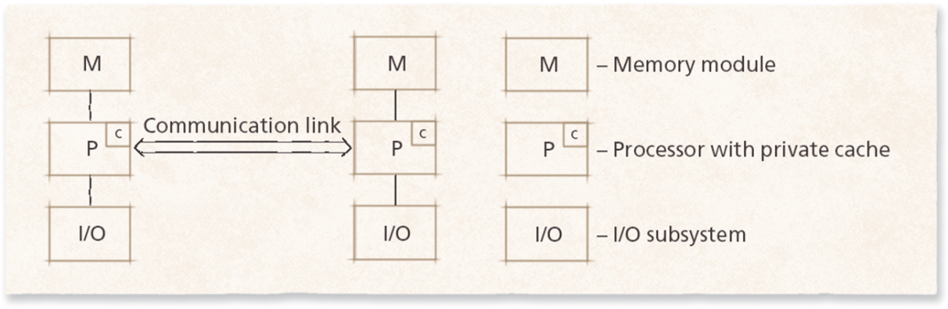
Loosely Coupled vs. Tightly Coupled Systems
Loosely Coupled
Tightly Coupled

Slide 14
Multiprocessor Operating System Organizations
Primary/secondary: one processor runs the OS, and the others only run user programs
  Simple, but if the primary fails, everything stops
  You may hear this called master/slave. We use primary/secondary instead, because the old terms come from slavery and can make people feel unwelcome, and the new terms describe the job just as clearly. The Linux kernel and many other projects have made the same change
Separate kernels: each processor runs its own copy of the OS. A failure only affects that processor
Symmetric: all processors share the OS and the work. The most fault tolerant, but it needs mutual exclusion
Notes:
Linux kernel coding style: inclusive terminology: https://docs.kernel.org/process/coding-style.html

Slide 15
Organizations Today
Windows, macOS, and Linux all use the symmetric design, called symmetric multiprocessing (SMP)
Phones with performance and efficiency cores still run one symmetric OS, but the scheduler treats the cores differently (later this week)
Historical note: the textbook examples, nCUBE, Tandem, and BBN Butterfly, are 1980s systems. Still worth knowing because the other designs still show up in embedded devices and research systems

Slide 16
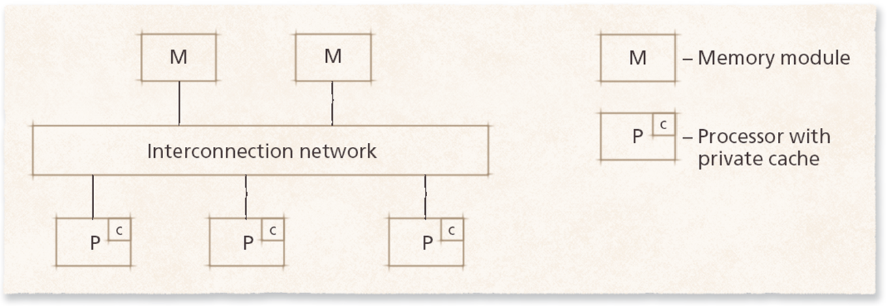
Uniform Memory Access (UMA)
All processors share all memory, at about the same speed
Usually connected by a shared bus or crossbar switch
Also called symmetric multiprocessing (SMP). Works well for a small number of processors

Slide 17
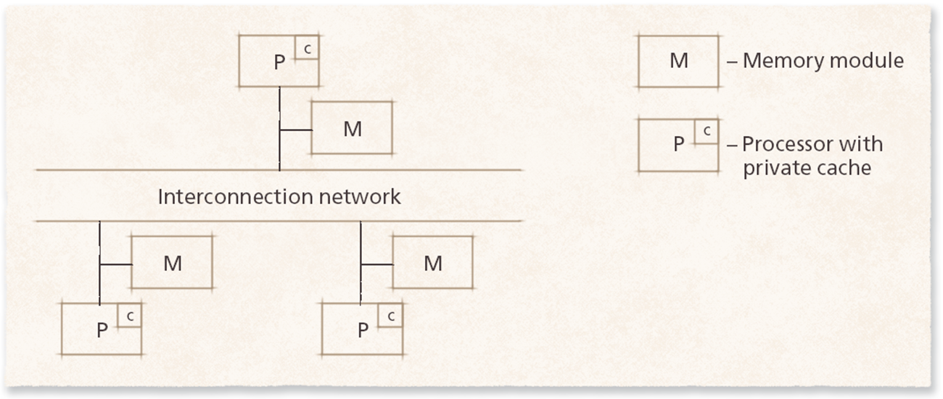
Nonuniform Memory Access (NUMA)
Each node has a few processors and its own local memory
Local memory is faster than memory on another node, and NUMA scales to bigger systems than UMA
Big servers today are NUMA. On Linux, lscpu or numactl --hardware shows the nodes
Notes:
Linux kernel documentation: What is NUMA?: https://docs.kernel.org/mm/numa.html

Slide 18
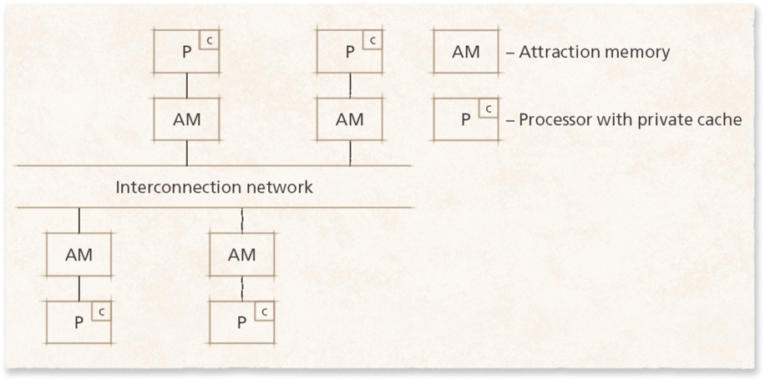
Other Memory Designs
COMA (cache-only memory architecture): each node's memory acts like a cache, and data moves to the node that uses it most. Mostly a research design
NORMA (no remote memory access): processors don't share memory at all, and talk by sending messages. This is really a distributed system (Week 14)

Slide 19
Multiprocessor Scheduling
Decides which process runs on which processor, and when
Two goals that pull against each other:
  Parallelism: run as much at the same time as possible
  Processor affinity: keep a process on the same core, because its data is already in that core's cache
Simple approaches use one shared line for all processors. Smarter ones keep related processes together
Linux gives each core its own run queue
You can pin a program to certain cores: Set affinity in Task Manager's Details tab, or taskset on Linux
Notes:
Linux kernel documentation: Scheduler: https://docs.kernel.org/scheduler/index.html
Linux manual page: taskset: https://man7.org/linux/man-pages/man1/taskset.1.html

Slide 20
Scheduling on Mixed Cores
Many chips mix performance cores and efficiency cores (Week 3)
The OS sends demanding work to performance cores, and background work to efficiency cores
  Intel's Thread Director gives the OS hints about each thread
This saves battery while keeping what you're using fast
Notes:
Intel: How Intel Core processors work: https://www.intel.com/content/www/us/en/gaming/resources/how-hybrid-design-works.html

Slide 21
Load Balancing
Spread the work evenly, so no processor sits idle while another is overloaded
Makes response times more consistent
Static: decide where work goes ahead of time. Works when the workload is predictable
Dynamic: move work while the system runs. Busy processors can hand work off, or idle ones can ask for more
Linux balances automatically. Watch htop while a big job runs, and you'll see the load spread across every core

Slide 22
Multiprocessor Mutual Exclusion: A Preview
When processors share data, two of them can try to change it at the same time
Mutual exclusion makes sure only one changes it at a time
Some tricks that work on one processor don't work with many, such as turning off interrupts, which only affects one core
This comes back in more detail in Week 6, Synchronization, including the locks that make it work

